Slide 1





Implementing collaboration between clients and NCC & EDIH-IS for HPC and AI.
Ingólfur
Department of Computer Science, University
Datathon Hagstofan, Iceland 2025

Slide 2








What kind of AI is useful for a small-data society?
Next generation AI
Need for small-data automation
Iceland and population base (Iceland vs. Denmark, Finland vs. California)
SMEs
Deep/recurrent/... neural networks: "Big-data" solutions
Solution: Intelligent reasoning
Reasoning from empirical measurements & data
Active sensing, active learning
Informed search

Slide 3
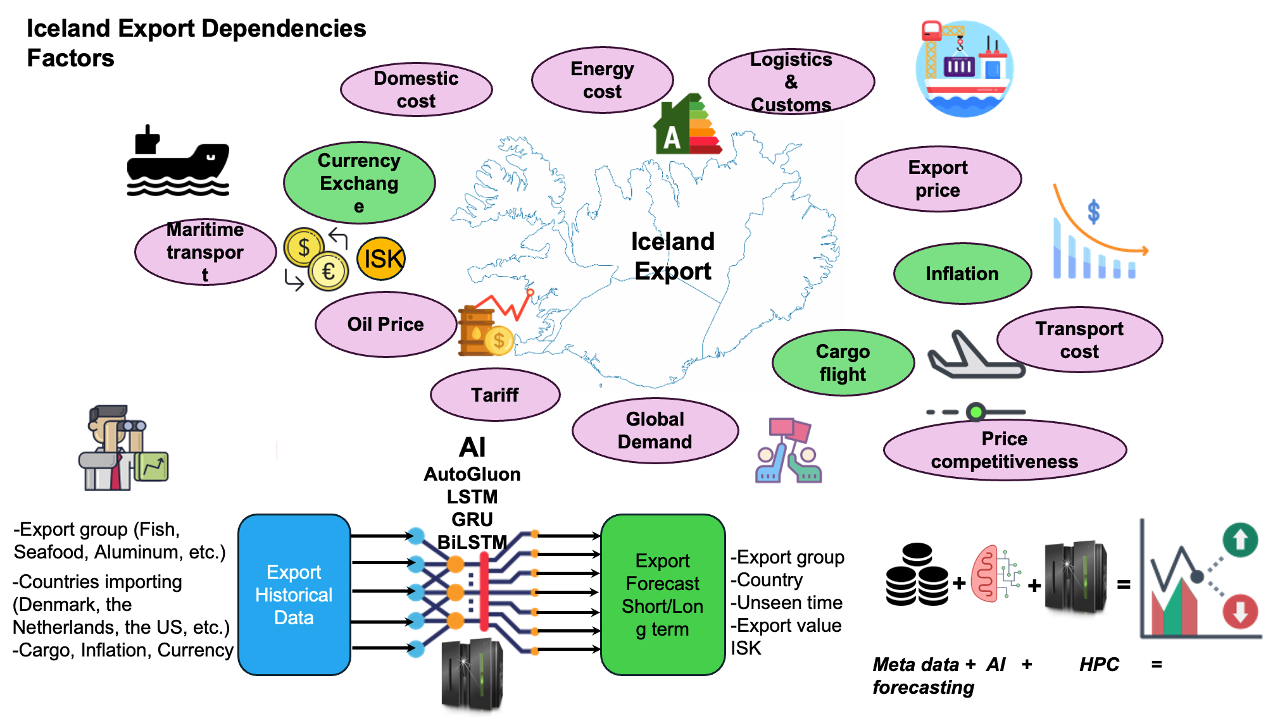
The UseCase

Slide 4
Use Case cont.
Based on open high value data sets.
  To use AI and high value datasets to predict future export of goods and sales from services to 1-250 countries using RNN models.
  To estimated accuracy of the LSTM model to predict
    sale export of services (Million ISK) and export of goods (Tonnes)
    future (24 month) sale export of services (Million ISK) and goods (Tonnes)

Slide 5
TensorFlow-LSTM Model
Dataset
Current data set (time interval: 2018-2025):
  All Service exports of processing to 250 countries.
  All export of goods to US.
  All export of goods to 250 countries.
  Intervals: Monthly.
  Available Variables: Million ISK and Thousand Tonnes.

Slide 6
Two rounds of training.
Prediction of export
Total services to 250 countries in MISK
  future_sales= service export to 250 countries in MISK
Total goods to USA in Thousand tonnes
  future_orders= total export of goods to US in Tonnes

Slide 7
Two rounds of training cont.
Training window is 12 months with 20% validation & 80% training data.
24 months unseen data with 12-month forwarding sliding window
Data used for training TensorFlow-LSTM.
  Real data in feature vector including 90 months of datapoints
  Data is normalized before training and validation starts

Slide 8
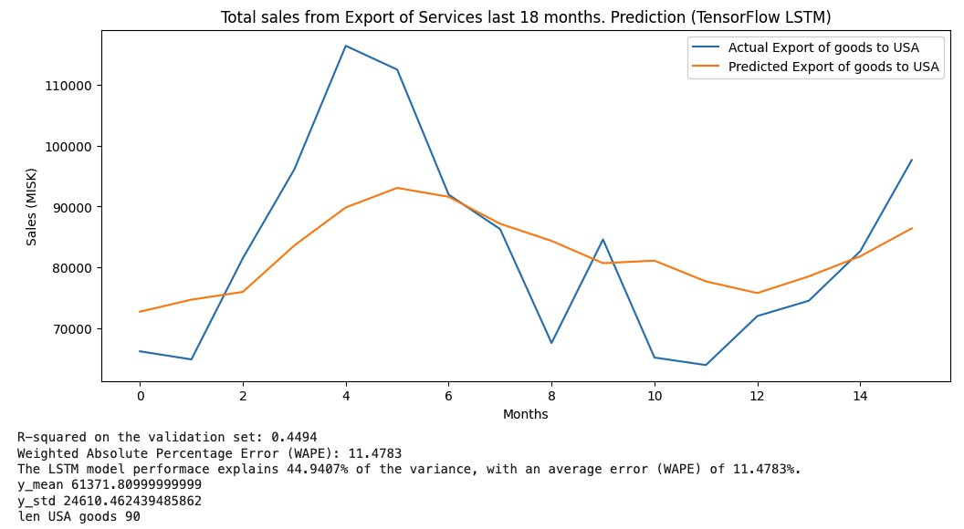
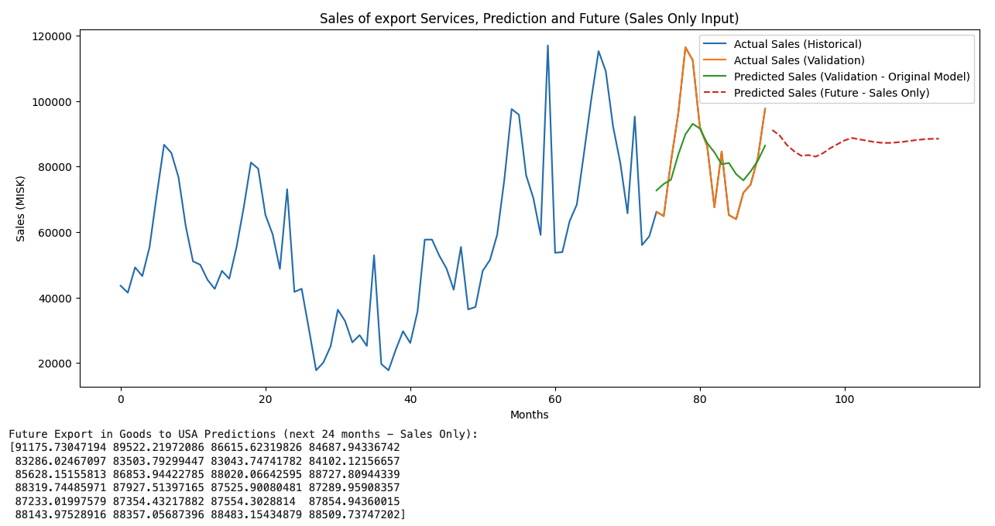
First round of training -services.
Total sales of services to 250 countries.
Single feature for sales of services, no external data

Slide 9
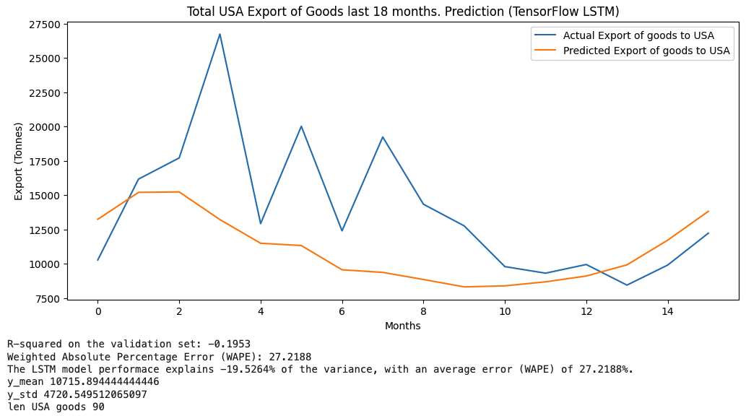
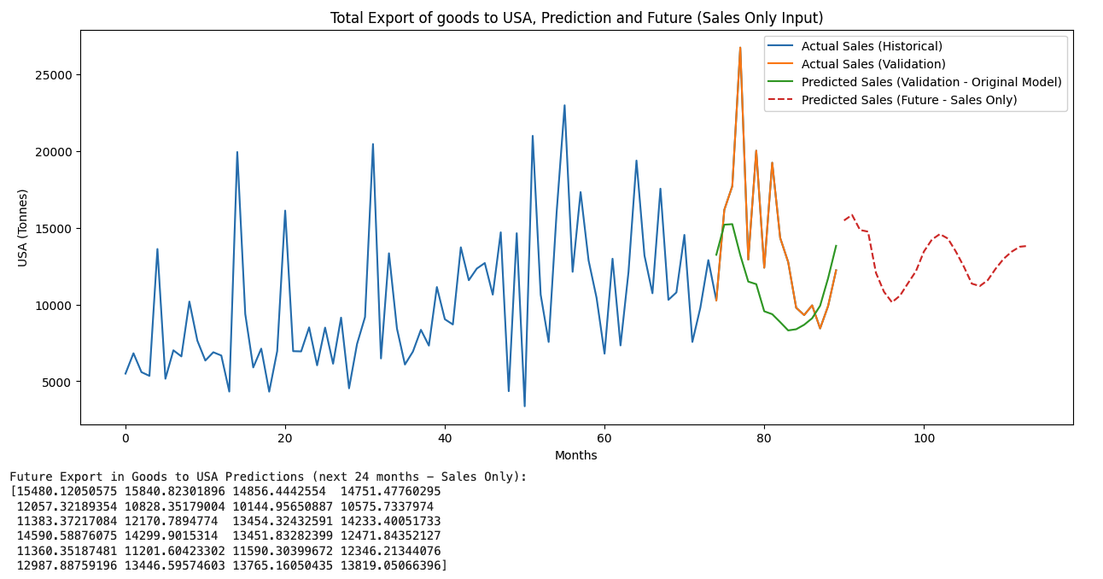
Second round of training – goods.
Total export of goods to USA.
Single feature for USA export of goods, no external data

Slide 10
Take out from the training rounds
The use of a 12-month rolling window on 24 months of unobserved data introduces uncertainty; a 12-month forecast horizon may be more reliable.
The feature vector includes two real-world datasets:
Total export of services to 250 countries (in millions of ISK)
Total exports to the US (in thousand of Tonnes)
No. Additionally, features from external datasets were included in the feature vector to improve model training. We found that the 'total exports to the US' feature had little predictive power for forecasting the sale of services. No correlation was done at this stage between the real-world datasets.

Slide 11
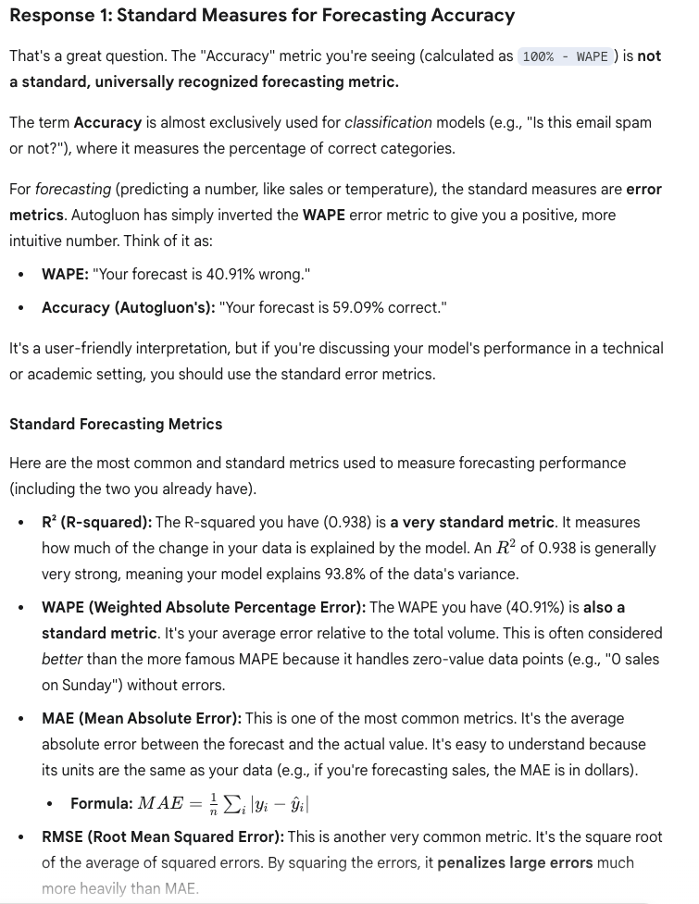
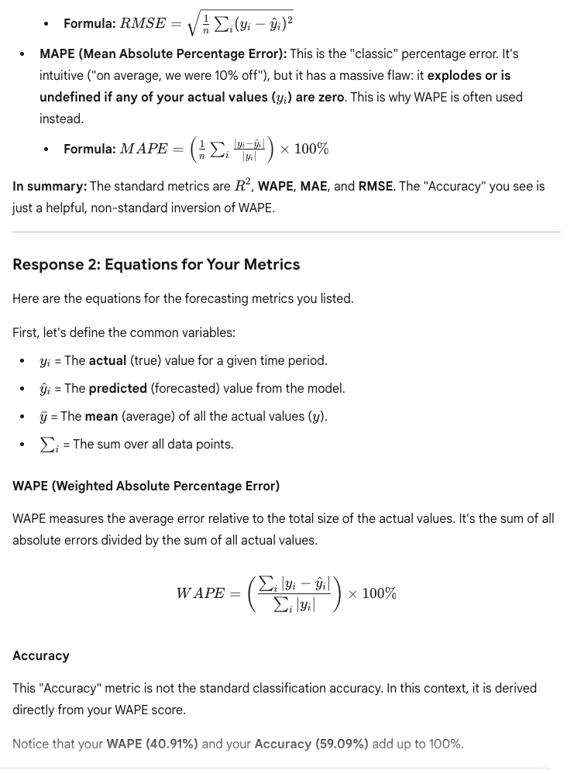
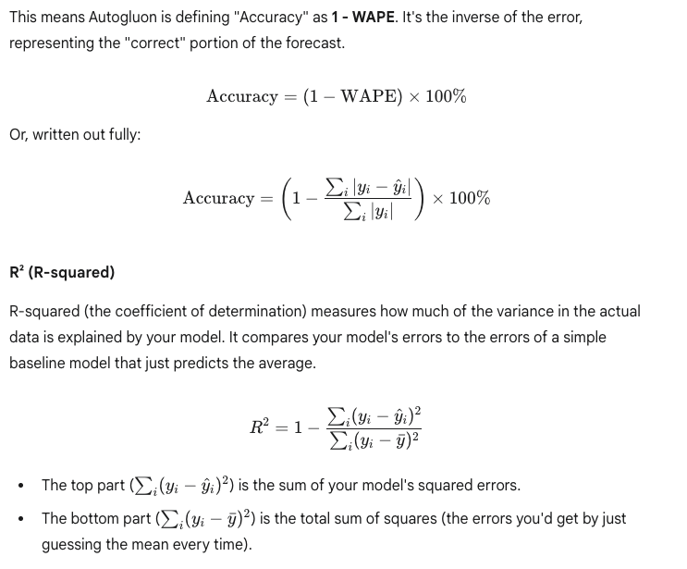
Equations for Accuracy

